Slide 1
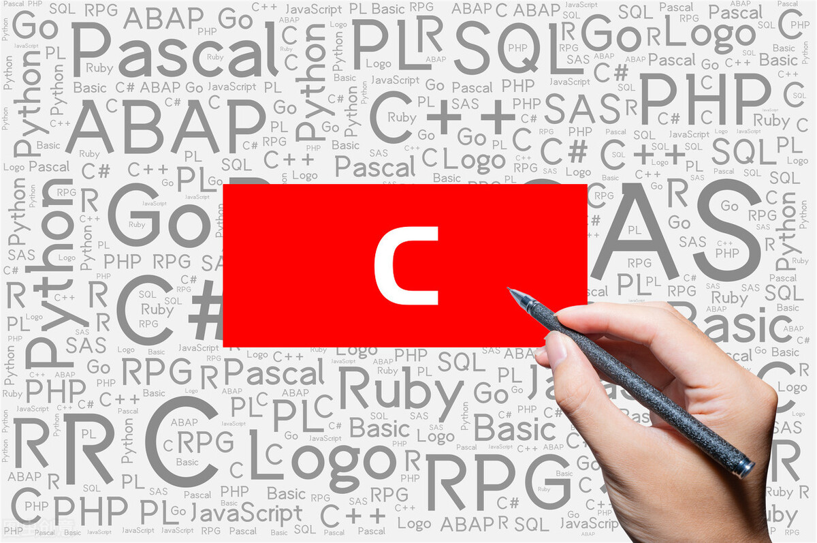
ADVANCE COMPUTER CENTRE IN DHURI
www.advancecomputercentre.com CONTACT US: 8556917707

Slide 2
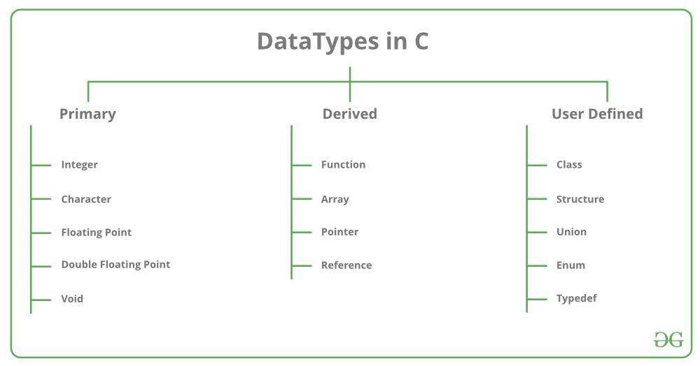
Data Types in C
www.advancecomputercentre.com CONTACT US: 8556917707

Slide 3
Data Types in C
Types | Description
Primitive Data Types | Arithmetic types can be further classified into integer and floating data types.
Void Types | The data type has no value or operator and it does not provide a result to its caller. But void comes under Primitive data types.
User Defined DataTypes | It is mainly used to assign names to integral constants, which make a program easy to read and maintain
Derived types | The data types that are derived from the primitive or built-in datatypes are referred to as Derived Data Types.
www.advancecomputercentre.com CONTACT US: 8556917707

Slide 4
Data Types in C
Data Type | Memory (bytes) | Range | Format Specifier
short int | 2 | -32,768 to 32,767 | %hd
unsigned short int | 2 | 0 to 65,535 | %hu
unsigned int | 4 | 0 to 4,294,967,295 | %u
int | 4 | -2,147,483,648 to 2,147,483,647 | %d
long int | 4 | -2,147,483,648 to 2,147,483,647 | %ld
unsigned long int | 4 | 0 to 4,294,967,295 | %lu
long long int | 8 | -(2^63) to (2^63)-1 | %lld
unsigned long long int | 8 | 0 to 18,446,744,073,709,551,615 | %llu
signed char | 1 | -128 to 127 | %c
unsigned char | 1 | 0 to 255 | %c
float | 4 | 1.2E-38 to 3.4E+38 | %f
double | 8 | 1.7E-308 to 1.7E+308 | %lf
long double | 16 | 3.4E-4932 to 1.1E+4932 | %Lf
www.advancecomputercentre.com CONTACT US: 8556917707

Slide 5
Keywords in C
A keyword is a reserved word. You cannot use it as a variable name, constant name, etc. There are only 32 reserved words (keywords) in the C language.
A list of 32 keywords in the c language is given below:
auto | break | case | char | const | continue | default | do
double | else | enum | extern | float | for | goto | if
int | long | register | return | short | signed | sizeof | static
struct | switch | typedef | union | unsigned | void | volatile | while
www.advancecomputercentre.com CONTACT US: 8556917707

Slide 6
C Identifiers
C identifiers represent the name in the C program, for example, variables, functions, arrays, structures, unions, labels, etc. An identifier can be composed of letters such as uppercase, lowercase letters, underscore, digits, but the starting letter should be either an alphabet or an underscore. If the identifier is not used in the external linkage, then it is called as an internal identifier. If the identifier is used in the external linkage, then it is called as an external identifier.
We can say that an identifier is a collection of alphanumeric characters that begins either with an alphabetical character or an underscore, which are used to represent various programming elements such as variables, functions, arrays, structures, unions, labels, etc. There are 52 alphabetical characters (uppercase and lowercase), underscore character, and ten numerical digits (0-9) that represent the identifiers. There is a total of 63 alphanumerical characters that represent the identifiers.
www.advancecomputercentre.com CONTACT US: 8556917707

Slide 7
Rules for constructing C identifiers
The first character of an identifier should be either an alphabet or an underscore, and then it can be followed by any of the character, digit, or underscore.
It should not begin with any numerical digit.
In identifiers, both uppercase and lowercase letters are distinct. Therefore, we can say that identifiers are case sensitive.
Commas or blank spaces cannot be specified within an identifier.
Keywords cannot be represented as an identifier.
The length of the identifiers should not be more than 31 characters.
Identifiers should be written in such a way that it is meaningful, short, and easy to read.
www.advancecomputercentre.com CONTACT US: 8556917707

Slide 8
Differences between Keyword and Identifier
Keyword | Identifier
Keyword is a pre-defined word. | The identifier is a user-defined word
It must be written in a lowercase letter. | It can be written in both lowercase and uppercase letters.
Its meaning is pre-defined in the c compiler. | Its meaning is not defined in the c compiler.
It is a combination of alphabetical characters. | It is a combination of alphanumeric characters.
It does not contain the underscore character. | It can contain the underscore character.
www.advancecomputercentre.com CONTACT US: 8556917707

Slide 9


ADVANCE COMPUTER CENTRE IN DHURI
NEXT TOPIC: DATA TYPES AND KEYWORDS
www.advancecomputercentre.com CONTACT US: 8556917707

